Slide 1
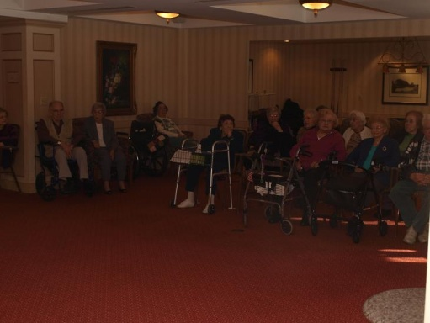
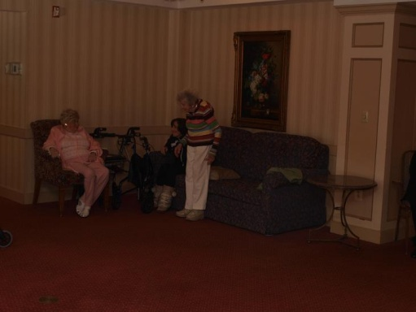
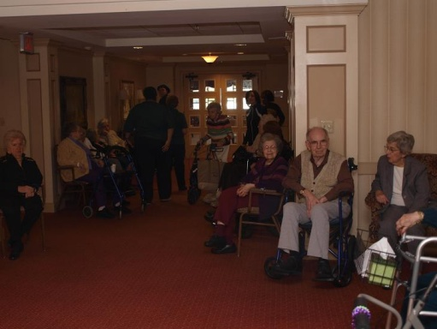
The Cherry Hill Field Trip to Brendenwood
Brendenwood is a retirement center in Voorhees, very close to where the Cherry Hill session meets on most Tuesday nights.
This was the fourth time that a performance has taken place there.
Many of the participants are familiar with the facility as relatives and friends are already residents of this retirement community.
Above we see some residents as they await the performance which was scheduled for 3:00 Pm on Sunday, January 30th
Accompanying music is Turkish Kiss, AKA Neshikat Turkit by the Turkish singer, Tarkan Tevetoglu

Slide 2
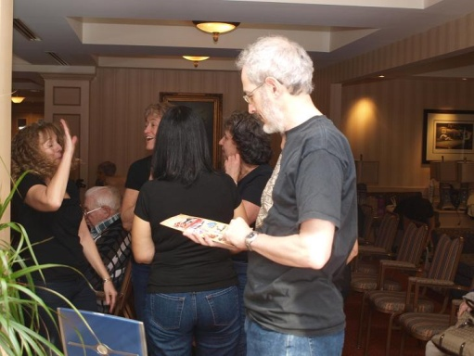
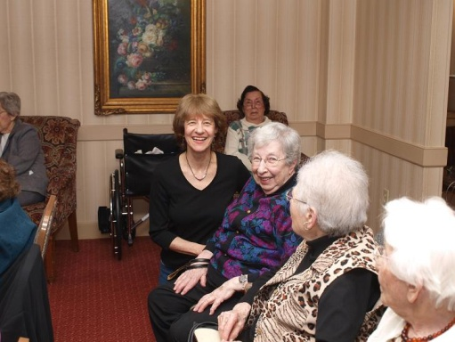
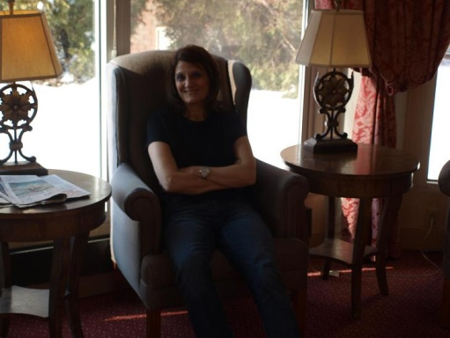
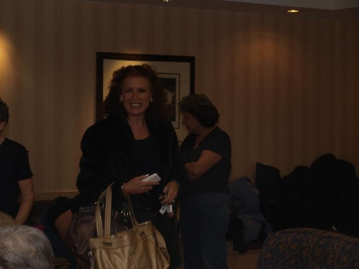
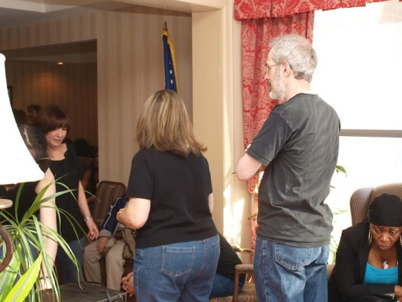
The dancers Arrive
Every dancer shown in this powerpoint presentation is a volunteer. Many of these dancers really are into Israeli dancing as the beat and music become somewhat addictive.
Each of these volunteers has a heavy schedule similar to your instructor and have plenty to do on a Sunday Afternoon. Many are travelling great distances to do this also.
Nevertheless, the opportunity to simultaneously dance and entertain others draws us to these events. Below, are some of the individuals who we see arriving
Gary who works at the Academy Of Natural Sciences
Deena, a librarian in Voorhees
Malca, a teacher, from Central New Jersey
Iris, a real estate broker on the Main Line
Ronnie, a geneticist

Slide 3
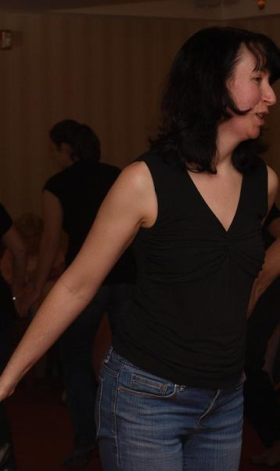
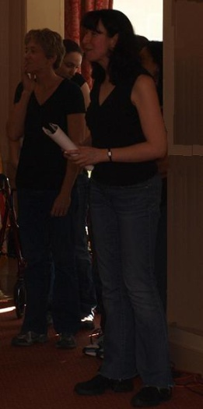
And so does Naomi, the group leader
Naomi, the leader of the Cherry Hill Tuesday night session, is the organizer of these events. Below, we describe her duties in her capacity as leader
Deal with the community management
Organize the “publicity”
Handle transit needs
Organize the dance repertoire
Bring the equipment
Prep the dancers
Introduce each dance to the audience
Participate in the dancing
Organize the after dancing get together dinner

Slide 4
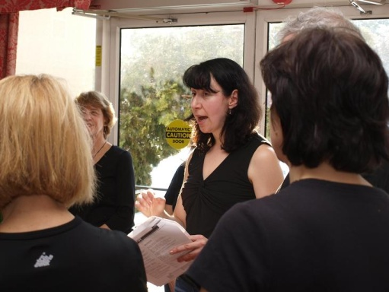
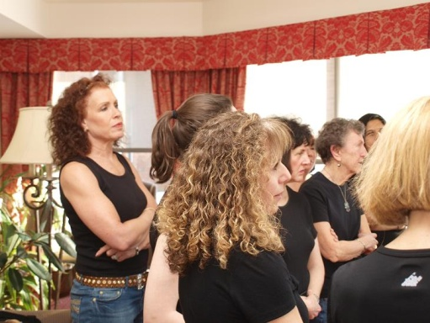
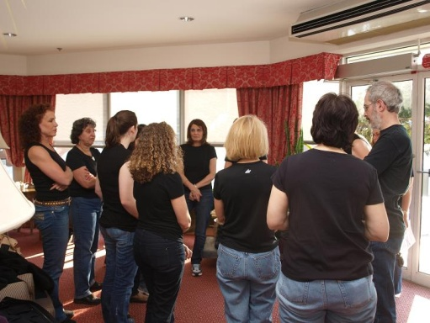
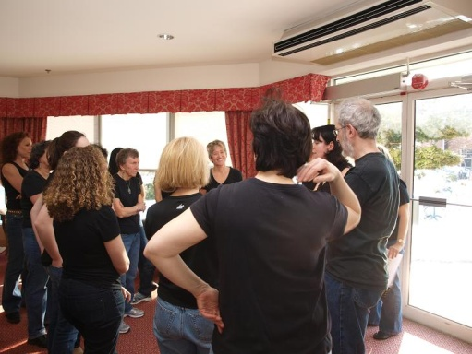
Naomi Preps her Dancers
Below are several pictures of Naomi’s prep to her dancers. This occurs a few minutes before the show goes on. Below, are some of the points she emphasizes
Smile, Smile, Smile
Small and aligned steps
If a dancer doesn’t know a dance, go to the sideline and take pictures
On several dances, include the audience by gesture and eye contact
Smile, Smile, Smile

Slide 5
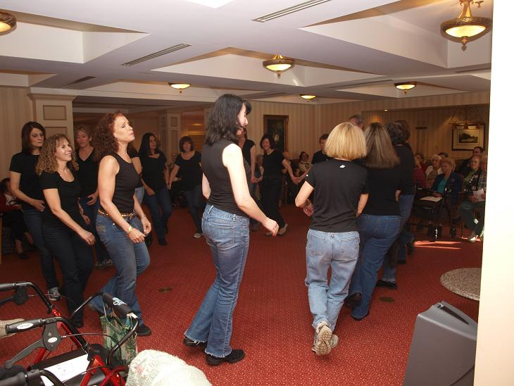
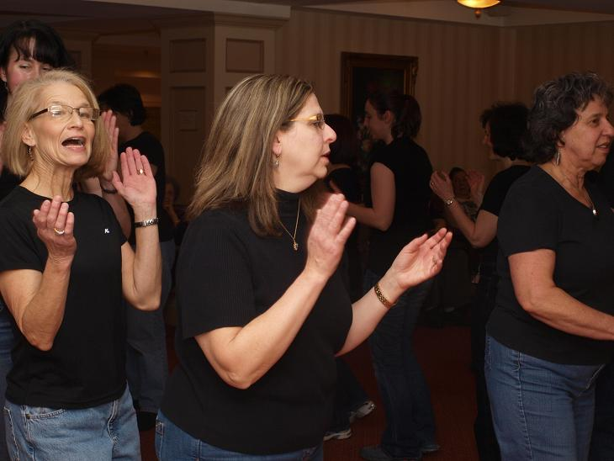
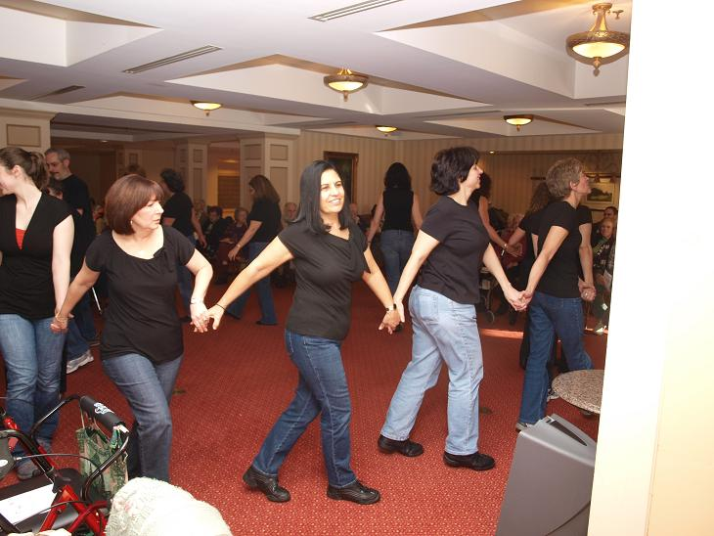
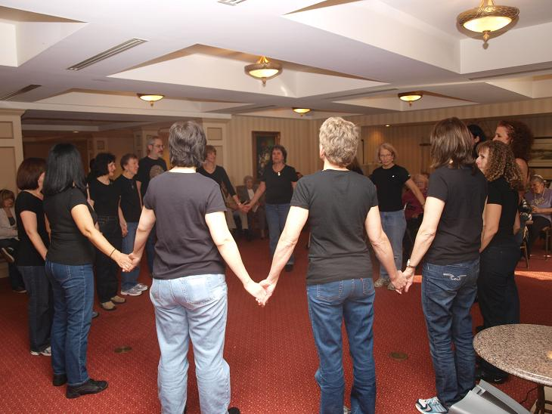
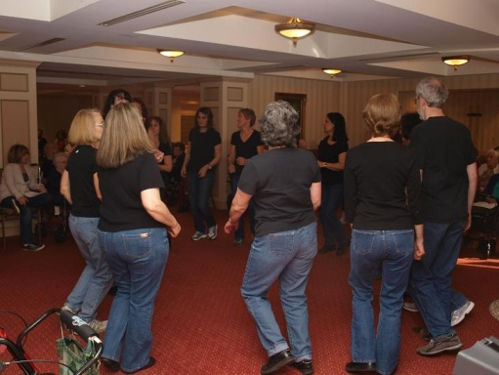
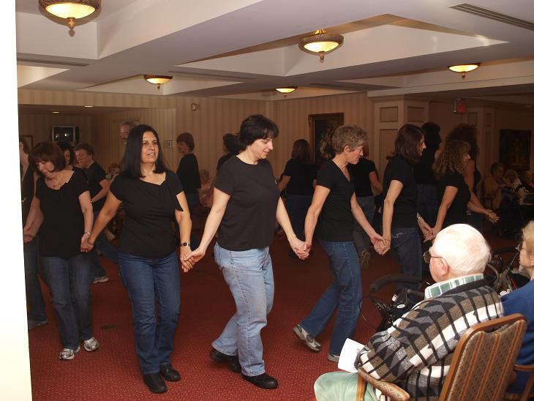
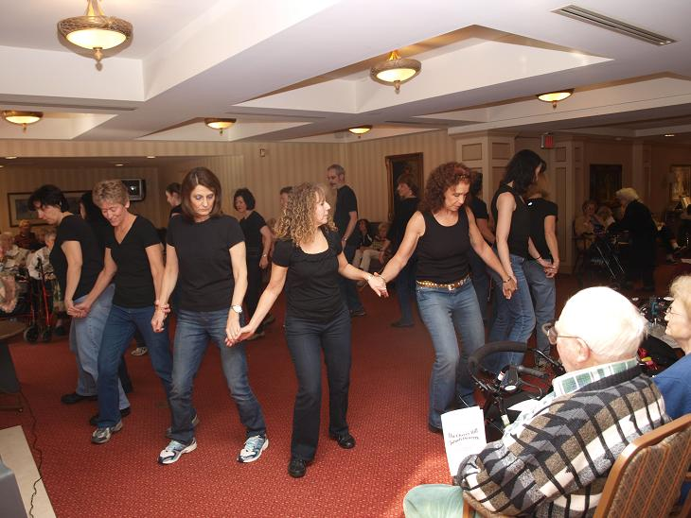
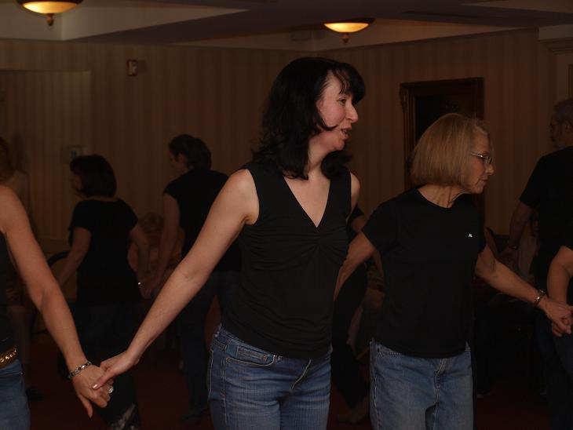
Israeli dancers love to dance. And, this Sunday was no exception. In the space of an hour, 12 dances were performed. This montage shows the group doing circles

Slide 6
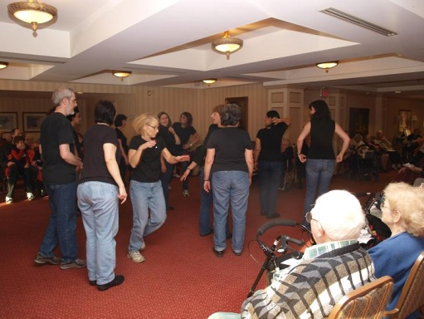
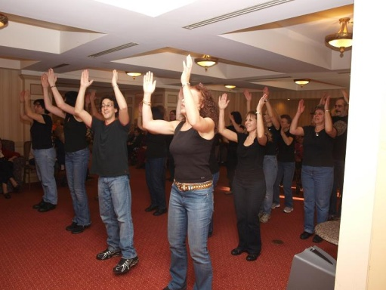
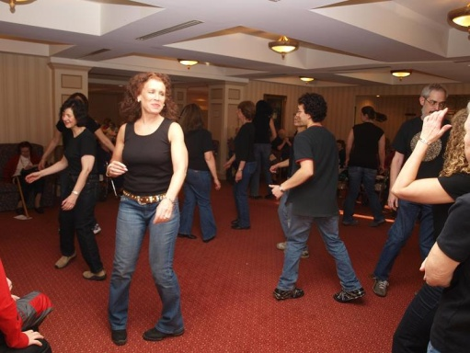
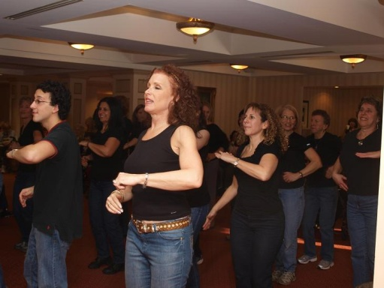
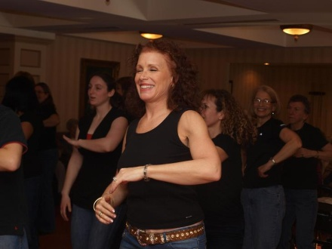
Israeli Dance is made up of three types of dances: Circle as indicated in the previous slide, Line and partner. Below are some pictures of a line dance
Israeli dancing is really the question of choreography. The dance music comes from all over the world. The pictures to the right are of Neshikat Turkit which translates as Turkish Kiss by the Turkish singer, Tarkan Tevetoglu.
The Israeli dance choreographer , Meir Shem Tov, put the steps together to go with the music.
We think you can see that the dancers enjoy both the music and steps.

Slide 7
What constitutes an Israeli Dance
A cultural ministry in Israel, part of the Israeli government, is in charge of cataloguing these dances
At the moment, it is estimated that 7000 such dances exist
A piece of music is required to have a defined set of steps
The music and the steps must pass muster being judged by a committee which can accept or deny the dance.
A choreographer pays to reserve the right to put steps to a piece of music. The music can come from any source in the world
The choreographer has a limited time to set up steps.
In addition, [s]he must produce documentation indicating why he has chosen these steps.
[S]he, the dance steps and the documentation are presented to the committee indicated above in Hebrew (which can be a limiting factor for some choreographers) and as stated, the committee can accept or deny
If accepted, the choreographer hopes to make a profit in the sale of CDs and DVDs and in invites to workshops where [s]he will be paid to present the dance

Slide 8
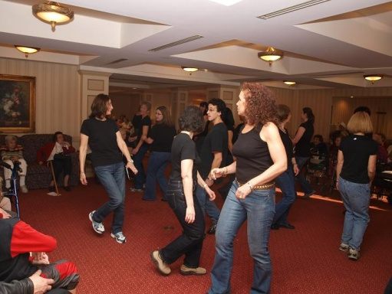
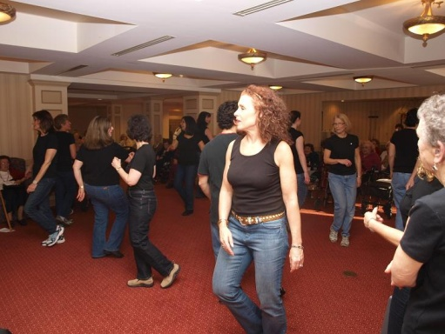
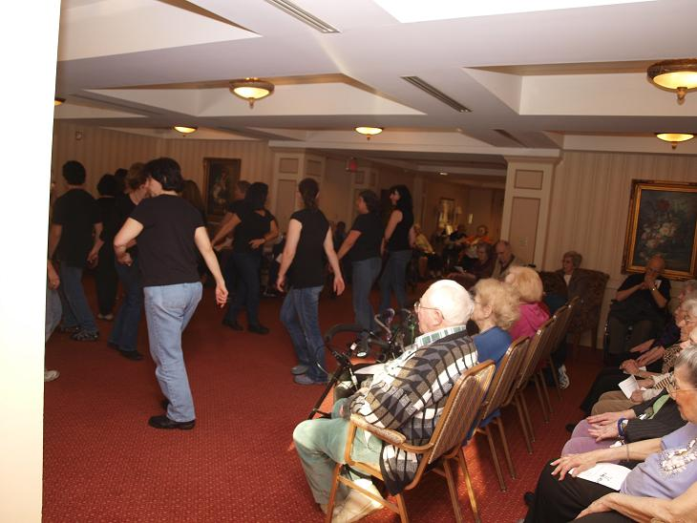
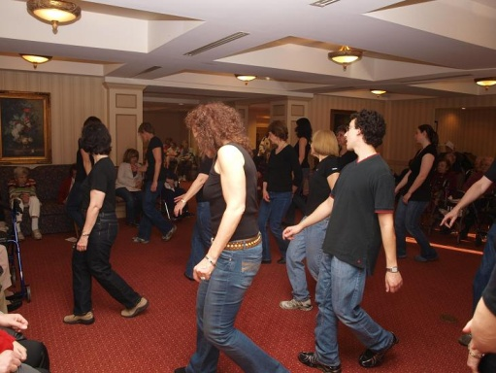
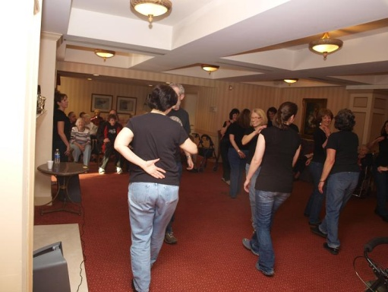
Let’s show a partner dance
We’ve shown you circles and lines. Below are pictures of the one partner dance done that afternoon. Israel partner dancing are a cross between international folk dance partners and ballroom partners having been influenced by both. This hybrid of dancing is more difficult than International folk dance partners but can be either easier or harder than ballroom. That’s what makes Israeli dance partners so interesting

Slide 9
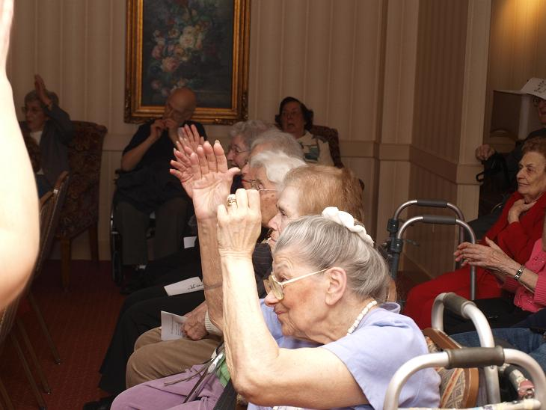
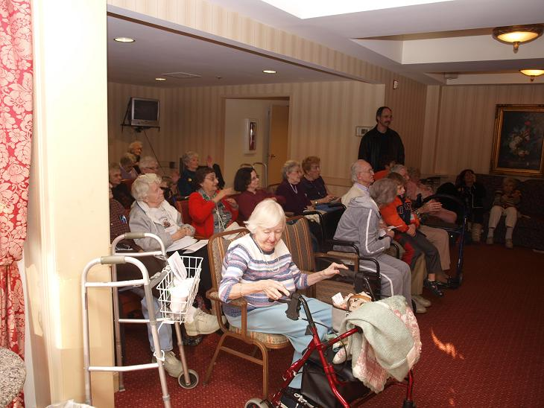
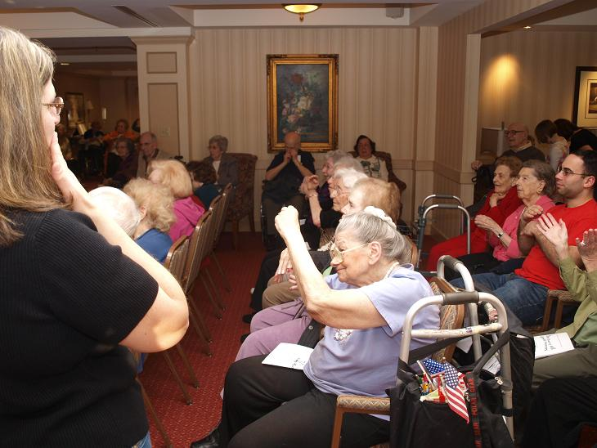
Audience Reaction
Retirement homes (under a variety of names) are generally between 3 to 1 and 5 to 1 female to male
These performances seem to draw from both sexes although the preponderance of the audience is Female.
Naomi makes sure to add dances where the audience can participate and the audience seems to enjoy this
In the time that these presentations have been done, no audience member has left prematurely
All the dancers are praised by the residents after the performance
It does help the mental cognitive ability of those in the audience to participate in functions like this

Slide 10
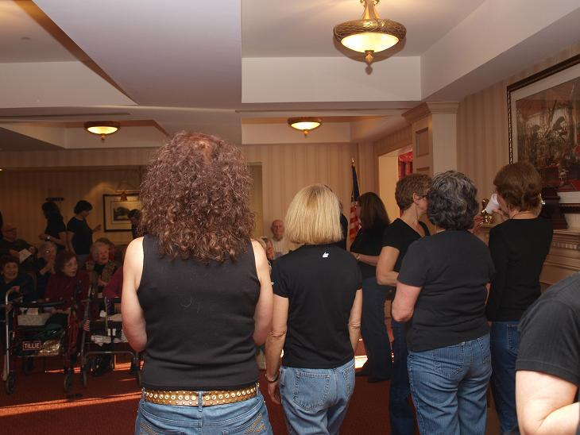
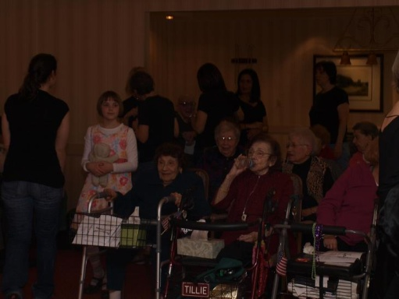
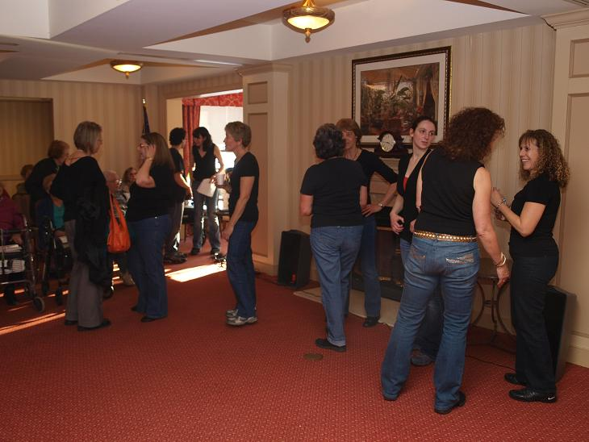
Time to Say Goodbye
All things come to an end and the dance presentation at Brendenwood ends about 3:00 to an enthusiastic round of applause.
This is the 4th time a Cherry Hill field trip has perfromed at Brendenwood and this had the most audience participation (someone counted 59 in the audience
It’s not the end of the day: a dinner is planned at a Chiness restaurant.
And it wasn’t the beginning of the day. This was one of 3 Israeli dance events in the Philadelphia area. FYI: your instrcutor did 2 of these by participating in a Sunday morning session also

